Slide 1
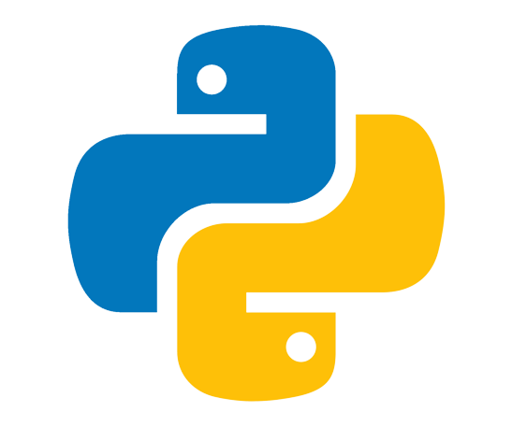

PYTHON PROGRAMMING

Slide 2
1. INTRODUCTION

Slide 3
INTRODUCTION
Python is an open source, general purpose programming language that is easy to read and powerful
It is an interpreted language, which do not need to be compiled to run
Python is high level language that will not make a programmer focus on what to do instead of how to do
Python has been designed to emphasize on code readability
Writing programs in python is less time consuming compared to any other language

Slide 4
HISTORY OF PYTHON
1980
1991
1994
2000
2008
2022
Python is developed by Guido Van Rossum
First version python 0.09 released
Python 1.0 version released with new features such as – lambda, map etc.
Python 2.0 released with several improvement
Python 3.0 released to help programmers to develop projects easily
Python 3.11.2 version released (Current)
2023- new version: 3.12

Slide 5
VERSIONS Current version is Python 3.12 Previous version - 3.11.2
Python 3 is an improved version. It supports Unicode characters. If we dive some integer, it gives the exact output. Earlier in python 2, we get a rounded value for the same. Most of the IT companies switching towards python3. It gets faster with every newer version. Also, Python has big library support for python3.
3.
11.
2
Bug fix & release.
Appx. (2) monthly
MAJOR VERSION
NEW FEATURES ADDED AND RELEASE.
Appx. Yearly

Slide 6
KEY FEATURES
Easy to code & easy syntax
Free and open source
Object oriented language
GUI Programming support
High-Level language
Interpreted language
Large ecosystem – built in libraries and packages
Dynamic typed language
‘ Glue ’ language

Slide 7
INTERPRETER & COMPILER
COMPILED LANGUAGE
INTERPRETED LANGUAGE
SOURCE CODE TO MACHINE CODE
compiler produces an executable file
Compiled programs tend to be faster
Debugging is comparatively hard
SOURCE CODE TO BYTE CODE THEN TO MACHINE CODE
Interpreter does not.
Interpreted programs tend to be slower
Debugging is easy

Slide 8
SCOPE OF PYTHON
Developing websites and software
Mobile app development
Task automation
Data analysis and visualization
Machine learning & AI
SEO
Game development
Finance and Accounting field

Slide 9
USED IN MANY MAJOR COMPANIES
Used in Google for design app engine & manage you-tube videos
Used in Netflix for their data security
PYTHON
Used in NASA for their data analysis and testing
IBM
MICROSOFT
UBER
AMAZON
FACEBOOK
INSTAGRAM

Slide 10
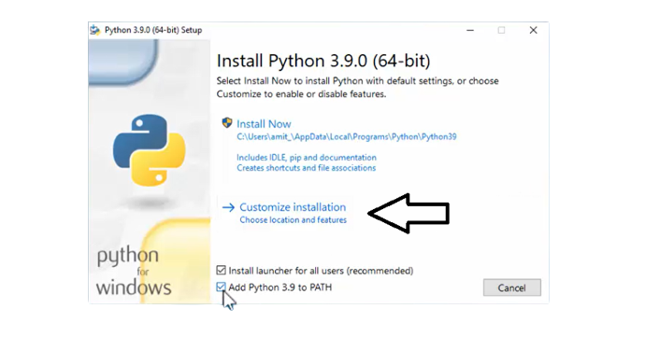
INSTALLATION
VISIT ‘python.org/Download’
Download for required Os
-Python for Windows, Linux/UNIX, macOS, Other
Add path & customize installation

Slide 11
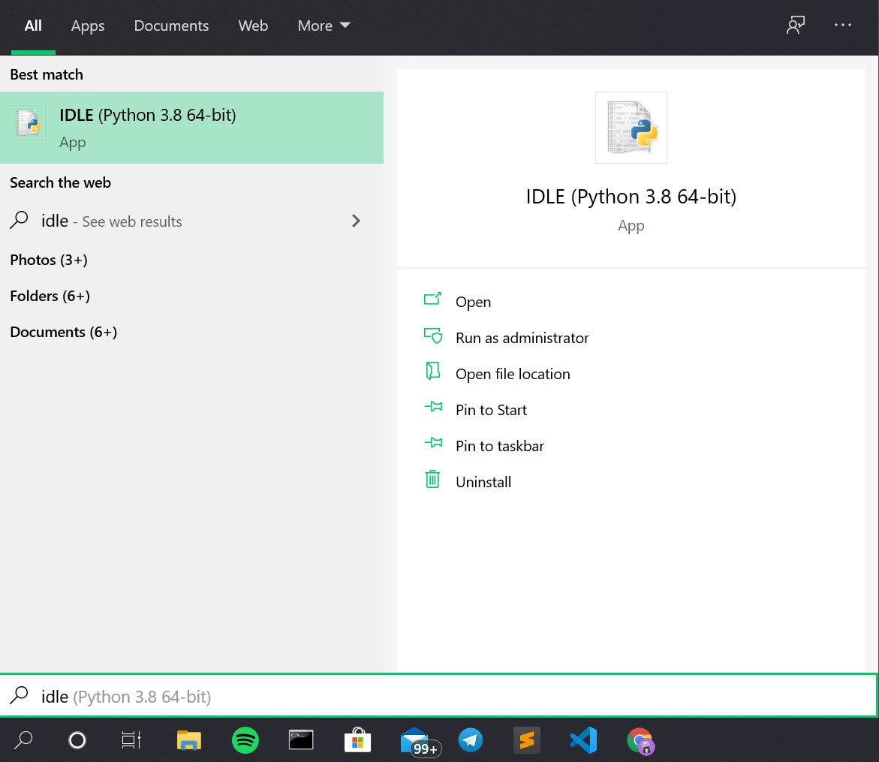
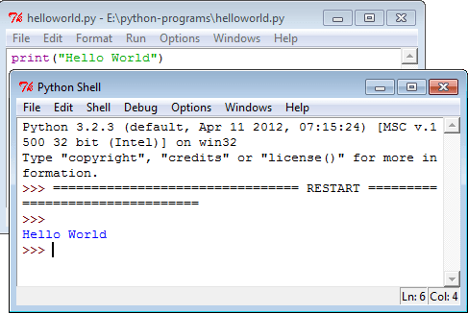
IDLE Development Environment
Included with python
Written in python
Allow us to running python files from the command line

Slide 12
SYNTAX
Simple programming syntax

Slide 13
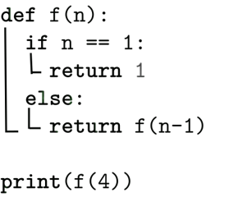
INDENTATION
The space at the beginning of a code line. Python uses the indentation to indicate block of code.
INDENTATION

Slide 14
2.VARIABLES & DATATYPES

Slide 15
Built-In DATATYPES
Defining Type of data or value
INTEGER (int)
Numbers without decimal point
Ex:- 20,4,6, etc.
NUMBER TYPE
FLOAT (float)
Numbers with decimal point
Ex:- 2.1, 4.6, etc.
COMPLEX TYPE
Complex numbers: Ex: 3i + 2j + 4k
CHARCTER TYPE
STRING (str)
Sequence of characters. Declare inside double or single quotes. Ex:- ‘a’, ‘python’
BOOLEAN TYPE
TRUE (bool)
True returns
FALSE (bool)
False returns
SEQUENCE TYPE
Group or sequence of variables. Ex: List, Set, Tuple
MAPING TYPE
Dictionary , Ex:
{‘Key’:’Value’}
MAP TYPE

Slide 16
VARIABLES & CONSTATNTS Both are used to store values.
Variables
Constants
Stores varying data.
Ex:-
It only contain one data at a time
Store constant values
Constants define in caps.
Ex:- PI = 3.14
GRAVITY = 9.8
It only contain one data at a time
a = 10
print(a) # output:- 10
a = 20
a=55
print(a) # output:- 55

Slide 17
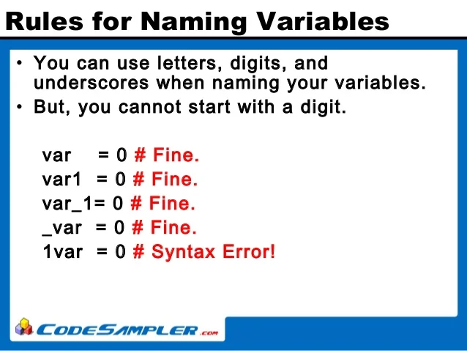
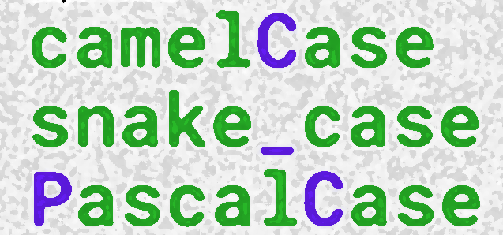
VARIABLE DECLARATION
‘=‘ OPERATOR IS USING TO ASSIGN OR STORE VALUES INTO A VARIABLE.
A variable can be declare in two methods:
Variable naming rules:
Variable name should be reliable to the value which is stored in it.
a = 1
b = 2
c = 3
# or
a, b, c = 1,2,3

Slide 18
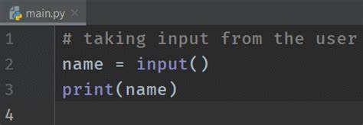


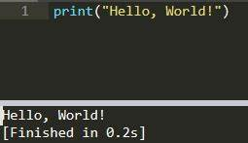
INPUT OUTPUT OPERATIONS
Input operation:
Data receiving from user to system.
Output operation:
Output Data to the screen
Input( )
user
print( )
user

Slide 19
3. BASIC OPERATORS

Slide 20
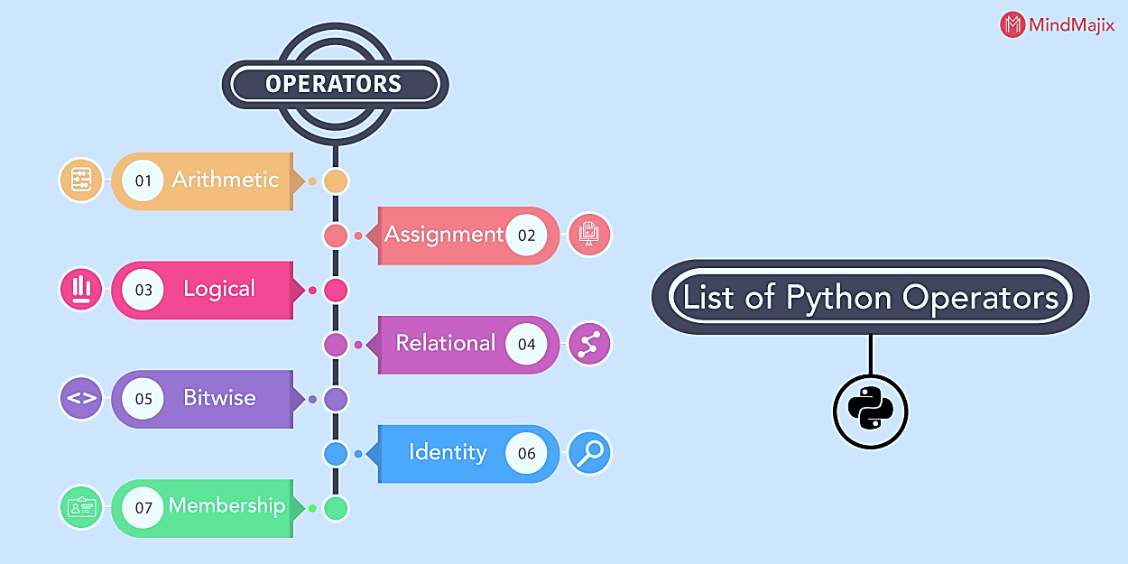
Operators in python Used to do different operations

Slide 21
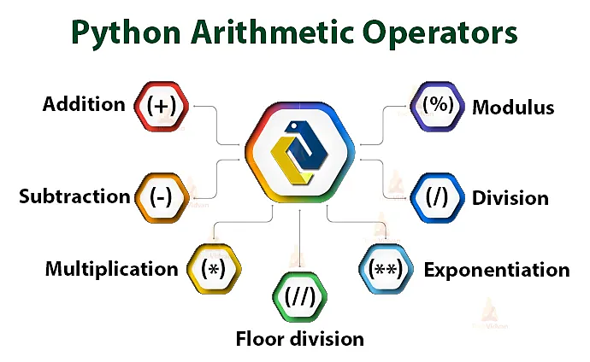
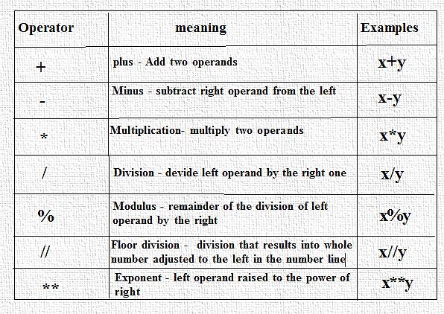
Arithmetic operators
For mathematical operations

Slide 22
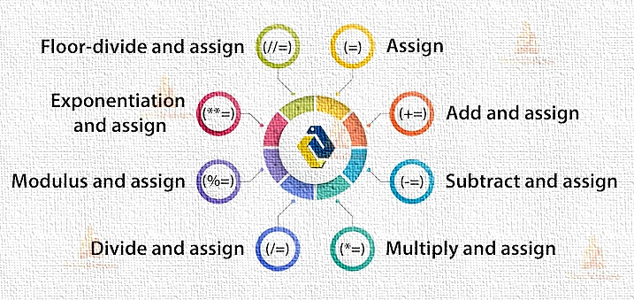
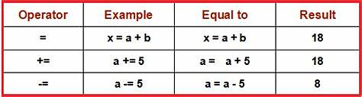
Assignment operator
Used to do operations and assign or store simultaneously.

Slide 23
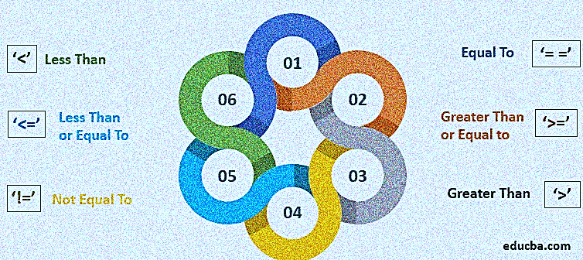
Comparison operator
Used to compare two values
== & != for equality check

Slide 24
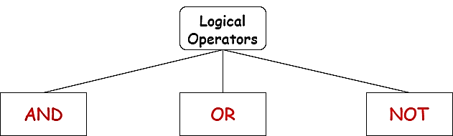
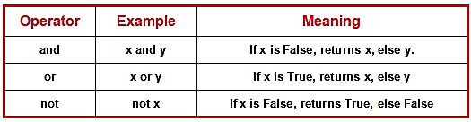
Logical operator
Used to combine two statements

Slide 25
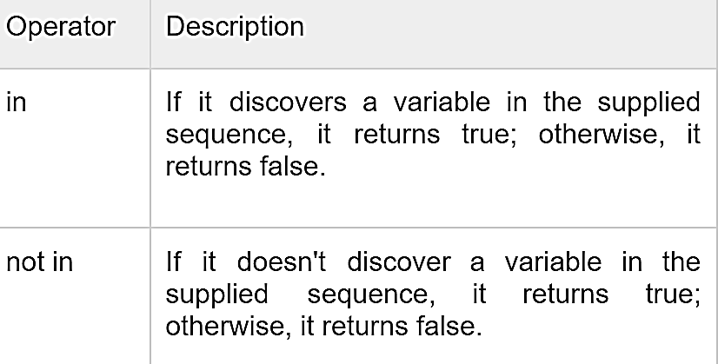
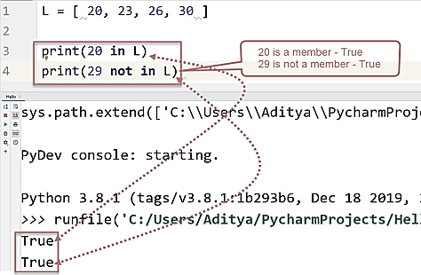
Membership operator
Check a member or object present in a sequence.

Slide 26
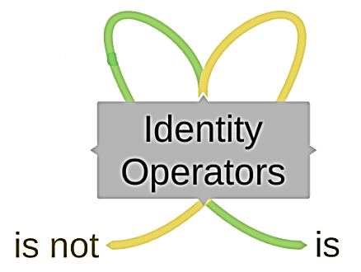
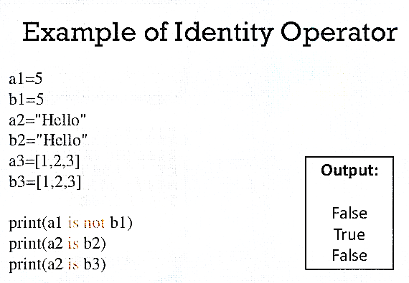
Identity operator
Used to compare & check equality of two values in different variables
Real life example:- password and confirm password checking in application form

Slide 27
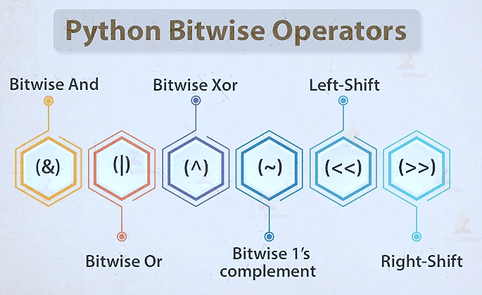
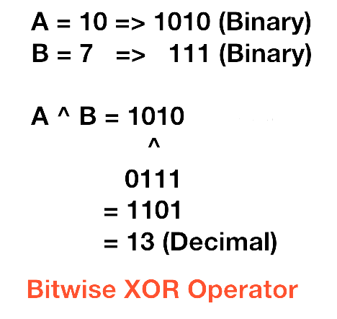
Bitwise operator
Comparing binary numbers.
Uses:- mouse movement in graphics & game development fields
EXAMPLE

Slide 28
4. STRING

Slide 29
STRING
Sequence of Characters
Used to store text or characters
Single line string defined inside of double quotes or single quotes.
Multi line string defined inside of triple quotes
Ordered and indexed
Example:
print('hello world')
multiline = """
python is high level language
python is interpreted language
python syntax is easy to read
"""

Slide 30
STRING SLICE
String can be slice by it’s index numbers
Example:
text = "Hello World"
print(text[0:3]) # Hel
print(text[:3]) # Hel
print(text[3:7]) # lo W
print(text[3:]) # lo World
print(text[-1]) # d
print(text[-2]) # l
print(text[-2:]) # ld
print(text[:-2]) # last two character skip
print(text[::-1]) # reverse order print
OUTPUT
Hel
Hel
lo W
lo World
d
l
ld
Hello Wor
dlroW olleH

Slide 31
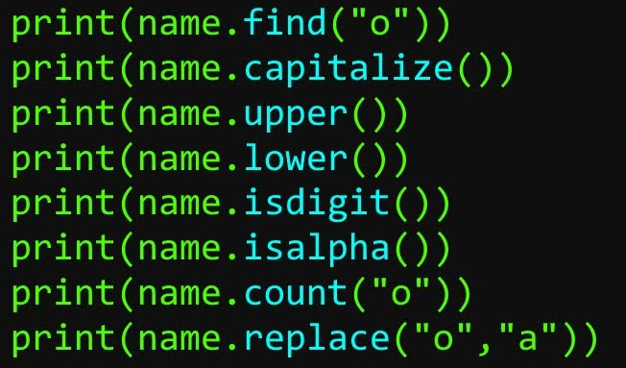
STRING METHODS
name = "Hello“

Slide 32
5. PYTHON COLLECTIONS

Slide 33
LIST
list in Python is used to store the sequence of various types of data.
lists are mutable type which implies that we may modify its element after it has been formed
List is ordered
List Allow Duplication.
list represent as square brackets-[]
Syntax:
list_obj=[“value1”,”value2”,…….]
We can create list using constructor
Syntax:
list_obj=list((“value1”,”value2”,…….))

Slide 34
LIST METHODS
ls=[“appu”,”anu”,25,3.0]
Methods | Usage | Example
Len() | Return length of list | ls.len()
Type() | Return type of variable | Print(type(ls))
Append() | Add an item at end of list | Ls.append(“value”)
Insert() | Add the item any where of the list | Ls.insert(indexNO,”value”)
Index() | To find the index of an item in list. | Print(index(“value”))
Remove() | Used to delete specified item in list using value. | Ls.remove(“value”)
Pop() | Used to delete specified item in list using index. | Ls.pop(indexNo)
del | Used to remove an item in specified index | Del ls[indexNO]
Clear() | Used to delete all item from list | Ls.clear()

Slide 35
TUPLE
Tuple is a group of items that are separated by commas.
Tuples are an immutable data type
Tuples are ordered sequences, each element has a specific order that will never change
Syntax:
variable_name = (value1,value2,value3,……,value n)
We can create using constructor
Syntax :
variable_name = tuple((value1,value2,value3,……,value n))

Slide 36
TUPLE METHOD
Methods are not support in tuple.
If we want add or remove item we need convert to list then add or remove using methods then reconvert to tuple.
Example :
tp=(1,2,3,4,5,6,7)
ls=list(tp)
ls.insert(2,10)
tp=tuple(ls)
print(tp)

Slide 37
SET METHODS
set is the collection of the unordered and unindexed items
Each element in the set must be unique.
sets remove the duplicate elements.
Sets are mutable which means we can modify it after its creation.
Syntax :
variable_name={“value1”,”value2”,…….}

Slide 38
SET METHODS
Methods | Usage | Example
add() | Add element to set | s.Add(value)
Remove() | Remove the element form set | s.Remove(value)
union(|) | Fetch the all item from two sets | Print(Seta |setb)
Intersect(&) | Fetch the common item from two sets | Print(Seta & setb)
Difference(-) | Fetch the commonless data from two sets | Print(seta - setb)

Slide 39
DICTIONARY
Python Dictionary is used to store the data in a key-value pair format.
It is the mutable data-structure.
The elements Keys and values is employed to create the dictionary
Keys must consist of just one element.
Value can be any type such as list, tuple, integer, etc.
Syntax :
variable={“key1”:”value1”, “key2”:”value2”, “key3”:”value3”}

Slide 40
DICTIONARY METHODS
dict={1:"a",2:"b",3:"c",4:"d",5:"e"}
Methods | Usage | Example
Len() | Return length of Dict | len(dict)
Type() | Return type of variable | Print(type(dict))
Update() | Add an item in dictionary | Dict.update({key:value})
Pop() | Used to delete specified item in Dict using index. | dict.pop(key)
Get() | Used to fetch the value using key,and value not in dict return null | Dict.get(key,”not available”)

Slide 41
6. CONDITIONAL STATEMENTS

Slide 42
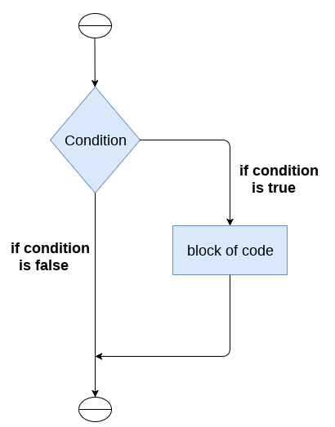
IF Statement
The if statement is used to test a specific condition. If the condition is true, a block of code (if-block) will be executed.
Syntax:
If Condition:
True Statement
Example :
if 5>3:
print(5+”is big”)

Slide 43
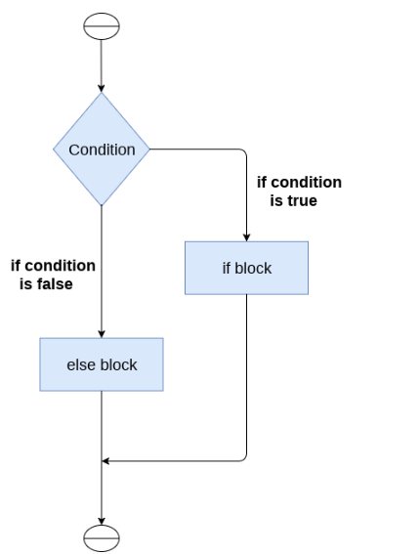
If – else Statement
The if-else statement is similar to if statement except the fact that, it also provides the block of the code for the false case of the condition to be checked. If the condition provided in the if statement is false, then the else statement will be executed.
Syntax :
If condition :
True Statement
Else:
False Statement

Slide 44
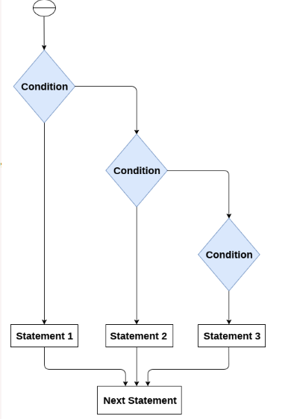
Nested –If Statement
Nested if statements enable us to use if ? else statement inside an outer if statement.
Syntax :
if condition :
if condition:
True Statement
else:
False Statement
else :
False Statement

Slide 45
7. LOOPING STATEMENTS

Slide 46
The following loops are available in Python to fulfil the looping needs. Python offers 3 choices for running the loops. The basic functionality of all the techniques is the same, although the syntax and the amount of time required for checking the condition differ.
We can run a single statement or set of statements repeatedly using a loop command.
The following sorts of loops are available in the Python programming language.

Slide 47
WHILE LOOP
While loops are used in Python to iterate until a specified condition is met.
However, the statement in the program that follows the while loop is executed once the condition changes to false.
Syntax :
while <condition>:
{ code block }
Example :
# Python program to show how to use a while loop
counter = 0
# Initiating the loop
while counter < 10: # giving the condition
counter = counter + 3
print("Python Loops")

Slide 48
FOR-LOOP
The for loop is often used to iterate over iterable objects such as lists, tuples, or strings.
The for-loop is usually used on an iterable object such as a list or the in-built range function.
Syntax :
for value in sequence:
{loop body}

Slide 49
8. CONTROL STATEMENTS

Slide 50
BREAK & CONTINUE & PASS
Break -The break is a keyword in python which is used to bring the program control out of the loop
The break statement breaks the loops one by one, i.e., in the case of nested loops, it breaks the inner loop first and then proceeds to outer loops.
In other words, we can say that break is used to abort the current execution of the program and the control goes to the next line after the loop
Example :
list =[1,2,3,4]
count = 1;
for i in list:
if i == 4:
print("item matched")
count = count + 1;
break
print("found at",count,"location");

Slide 51
BREAK & CONTINUE & PASS
Continue –
The continue keyword return control of the iteration to the beginning of the Python for loop or Python while loop
Example :
# Python code to show example of continue statement
# looping from 10 to 20
for iterator in range(10, 21):
# If iterator is equals to 15, loop will continue to the next iteration
if iterator == 15:
continue
# otherwise printing the value of iterator
print( iterator )

Slide 52
BREAK & CONTINUE & PASS
Pass :
The null statement is another name for the pass statement.
# Python program to show how to use a pass statement in a for loop
'''''pass acts as a placeholder. We can fill this place later on'‘’
sequence = {"Python", "Pass", "Statement", "Placeholder"}
for value in sequence:
If value == "Pass":
pass
# leaving an empty if block using the pass keyword
else:
print("Not reached pass keyword: ", value)

Slide 53
9. FUNCTIONS

Slide 54
FUNCTIONS
Function is a block of code which only run when it is called.
A Function returns data as result.
Def is used for the key word.
Function have parameter and argument.
Example :
def sum(a,b):
print(a+b)
sum(4,5)

Slide 55
TYPE OF FUNCTIONS
User Defined function
A function defined by user to perform specific operations.
Example:
def demo():
print(“Hello Synnefo”)
Built-in functions :
The Python built-in functions are defined as the functions whose functionality is pre-defined in Python
Example :
integer = -20
print('Absolute value of -40 is:', abs(integer))

Slide 56
Function with return
The return statement in python is an extremely useful statement used to return the flow of program from the function to the function caller.
Example :
def sum():
a=20
return a
Sum()

Slide 57
Function with argument & return
Example:
def sum(a,b):
return a+b
print(sum(20,20))

Slide 58
Function with argument & without return
Example :
def student(name,age):
print("student name is",name,"and age is",age)
student("alan",20)

Slide 59
Scope
Global Variable
Global variables are those we declare and define outside of any functions but not specific to any of them.
Example :
a=20 //global variable
print(“this is main function:-”,a)
f1():
print(“this is function 1:-”,a)
f2():
print(“this is function 2:-”,a)
f1()
f2()

Slide 60
Scope
Local Variable
Global variables are those we declare and define inside of any functions.
Example :
f1():
a=20
print(“this is function 1:-”,a)
f1()

Slide 61
Scope
We can access the local variable from outside of the functions using “global” keyword.
Example:
f1():
global a=20
print(“this is function 1:-”,a)
f2():
print(“this is function 2:-”,a)
f1()
f2()

Slide 62
Functional programing
Example :
sum(a,b):
return a+b
square(c):
return c*c
result=aquare(sum(2,3))
print(result)

Slide 63
Lambda function
Lambda Functions in Python are anonymous functions, implying they don't have a name.
The def keyword is needed to create a typical function in Python, as we already know.
We can also use the lambda keyword in Python to define an unnamed function.
Syntax :
lambda arguments: expression
Example :
x = lambda a,b :a+b
print(x(2,3))

Slide 64
Recursive function
A Function Call it self.
Example :
def fact(n):
if n == 1:
return n
else:
return n*fact(n-1)
num=input(“Enter a number for find factorial :”)
if num < 0:
print("Sorry, factorial does not exist for negative numbers")
else if num == 0:
print("The factorial of 0 is 1")
else:
print("The factorial of", num, "is", fact(num))

Slide 65
10.OBJECT OREINTED PROGRAMMING (OOPS)

Slide 66
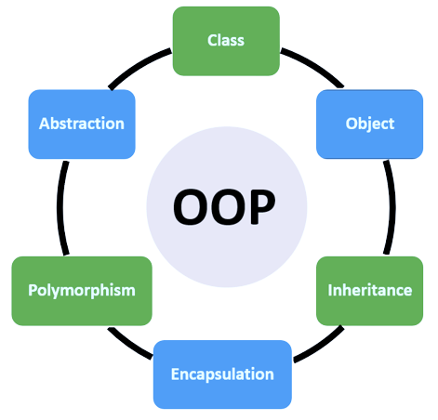
What is Object Oriented Programming ?
OOP is the most popular programming concepts used for software development. It relies on the concept of classes and objects. It is used to structure a software program into simple, reusable. It implement real world entities into programming.
Entities – A thing or a object in the real world.
OOPS CONCEPT

Slide 67
CLASS AND OBJECTS
CLASS
OBJECT
Blueprint or template or a design of objects.
Allow multiple object in same class
It’s a logical entity. No physical existence.
Not allocating any memory space
Declare a class by using ‘class’ keyword.
Instance ( Representative ) of a class.
It Allow to use the properties & methods inside a class & Each one has different properties & methods
Each object has separate memory space.
It is a physical entity & it can be modify
No specific keyword to create a object.

Slide 68
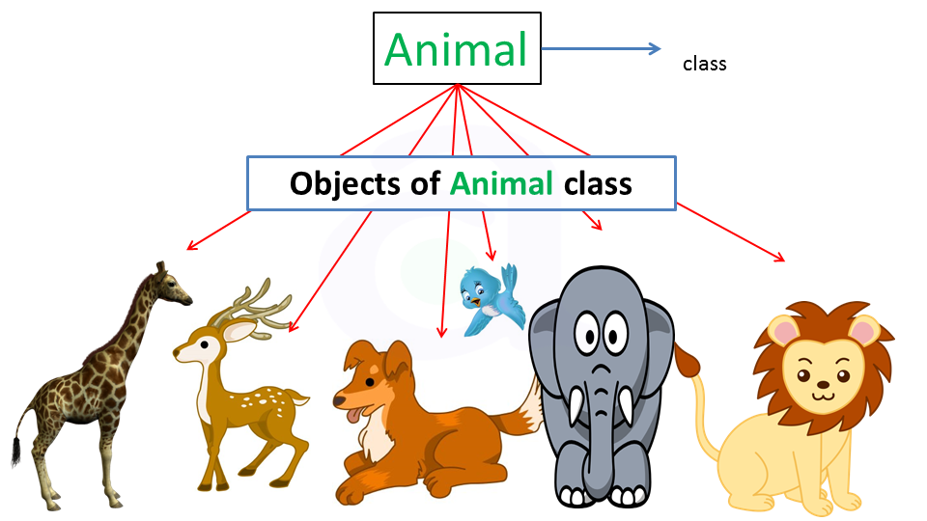
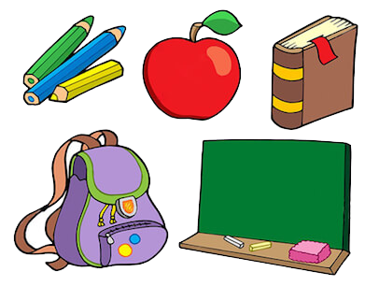
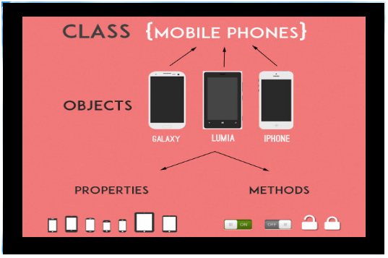
Examples of Class & Objects
REAL WORLD OBJECTS

Slide 69
CLASS & OBJECT CREATION
Class Sample:
def Hello(self):
name = ‘Nia Sharma’
print(‘my name is’, name)
Object = Sample()
O b j e c t . Hello()
Class declaration
Object creation
Function call by object

Slide 70
INHERETANCE
Inheritance is a way of representing real-world relationships between the two.
It is the procedure in which one class inherits the attributes and methods of another class. The class whose properties and methods are inherited is known as the parent class or superclass. And the class that inherits the properties from the parent class is the child class or derived Class.
PAPRENT CLASS OR SUPER CLASS
Inherit to
CHILD OR DERIVED CLASS

Slide 71
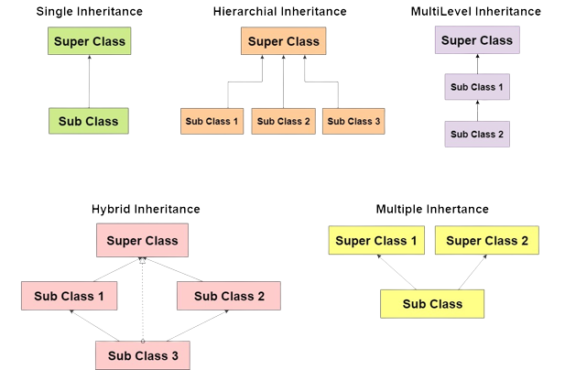
Types of Inheritance
SINGLE INHERITANCE
MULTIPLE INHERITANCE
MULTI-LEVEL INHERITANCE
HYBRID INHERITANCE
HIERARCHIAL INHERITANCE

Slide 72
SINGLE INHERETANCE
Single inheritance is when the class inherits from only one class &the child class may have it’s own properties and methods..
class university:
def display(self):
print('my name is john')
class faculty(university):
pass
object = faculty()
Object . display()
Parent class
child class
Object of child class

Slide 73
MULTIPLE INHERETANCE
When a class is derived from more than one base class it is called multiple Inheritance. The derived class inherits all the features of the base case
class university:
def display1(self):
print('my name is john')
class faculty(university):
pass
class students(university):
def display2(self):
print('my age is 21’)
object = faculty()
object.display1()
object_2 = students()
object_2.display2()

Slide 74
MULTILEVEL INHERETANCE
we inherit a derived class from a base class and another derived class from the previous derived class up to any extent of depth of classes in python is called multilevel inheritance.
class university:
def display1(self):
print('my name is john')
class faculty(university):
pass
class students(faculty):
def display2(self):
print('my age is 21')
object = students()
object.display1()
object.display2()

Slide 75
HIERARCHIAL INHERETANCE
Hierarchical inheritance is a type in Python where you can inherit more than one class from the base or parent class. The child class inherit all the properties of the two parent class.
class University:
def display1(self):
print('my name is john')
class Faculty():
def display2(self):
print('my age is 21')
class students(University, Faculty):
pass
object = students()
object.display1()
object.displa2()

Slide 76
HYBRID INHERETANCE
Hybrid inheritance is a combination of multilevel inheritance and multiple inheritance.
class university:
def display1(self):
print('my name is john')
class faculty(university):
pass
class students(university):
def display2(self):
print('my name is 21')
class department(faculty, students):
pass
object = faculty()
object.display1()
object_2 = students()
object_2.display2()

Slide 77
Polymorphism

Slide 78
Example for polymorphism

Slide 79
Encapsulation

Slide 80
Abstraction

Slide 81
11. MODULES

Slide 82
Math module

Slide 83
J-son module

Slide 84
Regex module

Slide 85
Datetime module

Slide 86
Regex module

Slide 87
12. PIP

Slide 89
13. EXCEPTION HANDLING

Slide 92
14. FILE HANDLING

Slide 93
USES

Slide 94
READ & WRITE

Slide 95
OS & SHUTIL MODULE

Slide 96
GUI & FEATUES

Slide 97
TKINTER

Slide 98
SIMPLE CALCULATOR BY TKINTER

Slide 99
END

